Slide 1
Hall Effect Sensors
Jayden Marcom (Team 5)

Slide 2
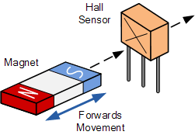
What Are Hall Effect Sensors
Makes use of the Hall Effect
Magnetic field Sensor

Slide 3
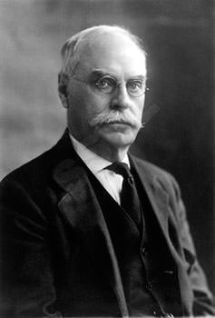
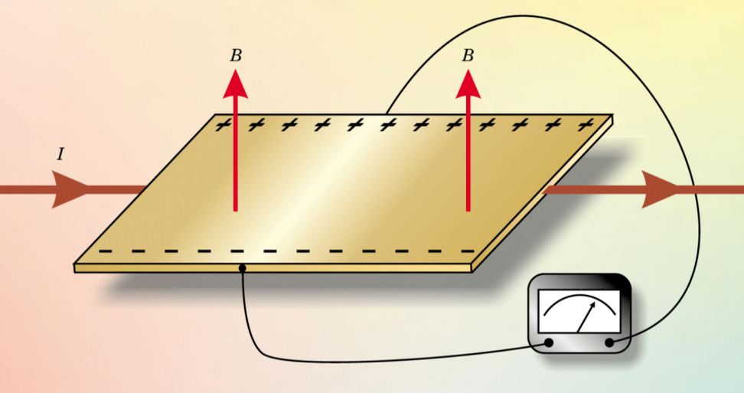
What is the Hall Effect
Edwin Herbert Hall in 1879
Repeated experiment by Henry Augustus Rowland
Gold leaf
Electromagnets

Slide 4
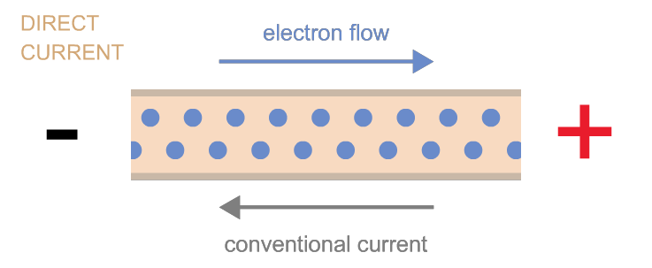
Understanding the Hall Effect
Begin with a current flowing through a conductor. Then place it within a magnetic field.

Slide 5
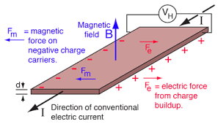
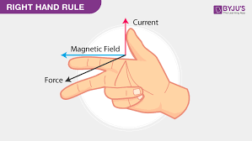
Understanding the Hall Effect
Lorentz Force
Electric force from charge buildup
Pushes Electrons/Protons to one side

Slide 6
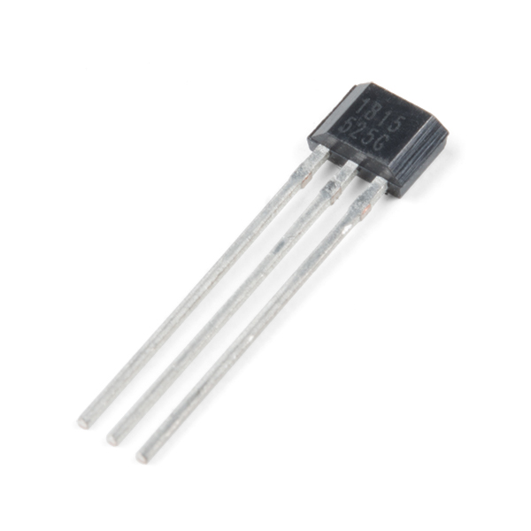
Composition of Hall Effect Sensors
Gallium Arsenide, Indium Arsenide, or Indium Antimonide
Dc amplifier
Input, Output, and ground Leads

Slide 7
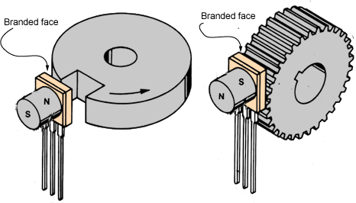
Uses of Hall Effect Sensors
Hall Effect sensors are used in a variety of products (bicycles, phones, keyboards, etc.)
Speed Sensors
Pressure Sensors
Current Sensors
Magnetic Field Sensors

Slide 8
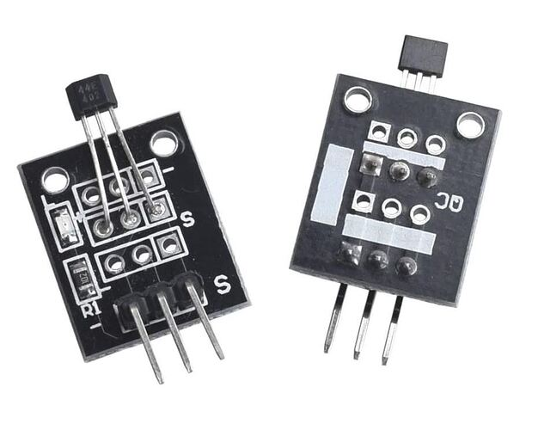
How to use a Hall Effect Sensor
Effective Range
Voltage Range
Type of Hall Effect Sensor

Slide 9
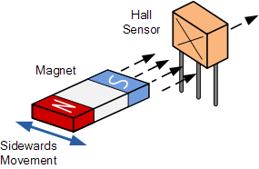
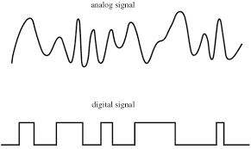
Types of Hall Effect Sensors
Typically designed to turn on
Digital or Linear(analog) outputs
Bipolar or Unipolar
Specialization in sideways vs head-on

Slide 10
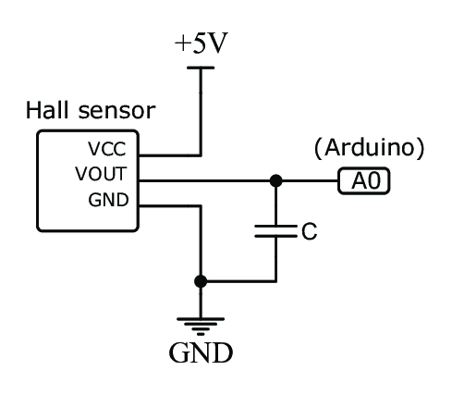
Voltage Range of Hall Effect Sensor
Choice of range
Digital or Analog
Cutting of the voltage range

Slide 11
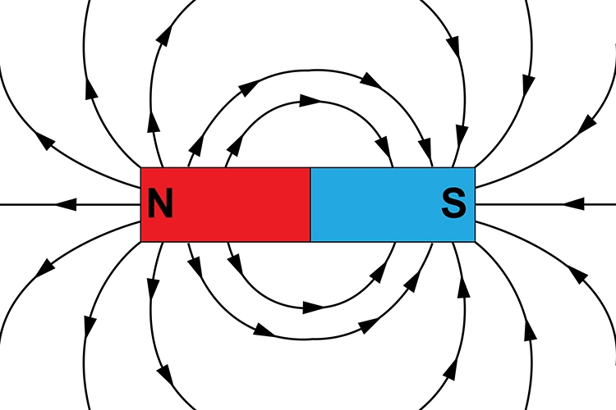
Effective Range of Hall Effect Sensor
Gauss rating of sensor(1 Telsa = 10,000 Gauss)
Magnet size or distance
Apply an appropriate formula

Slide 12
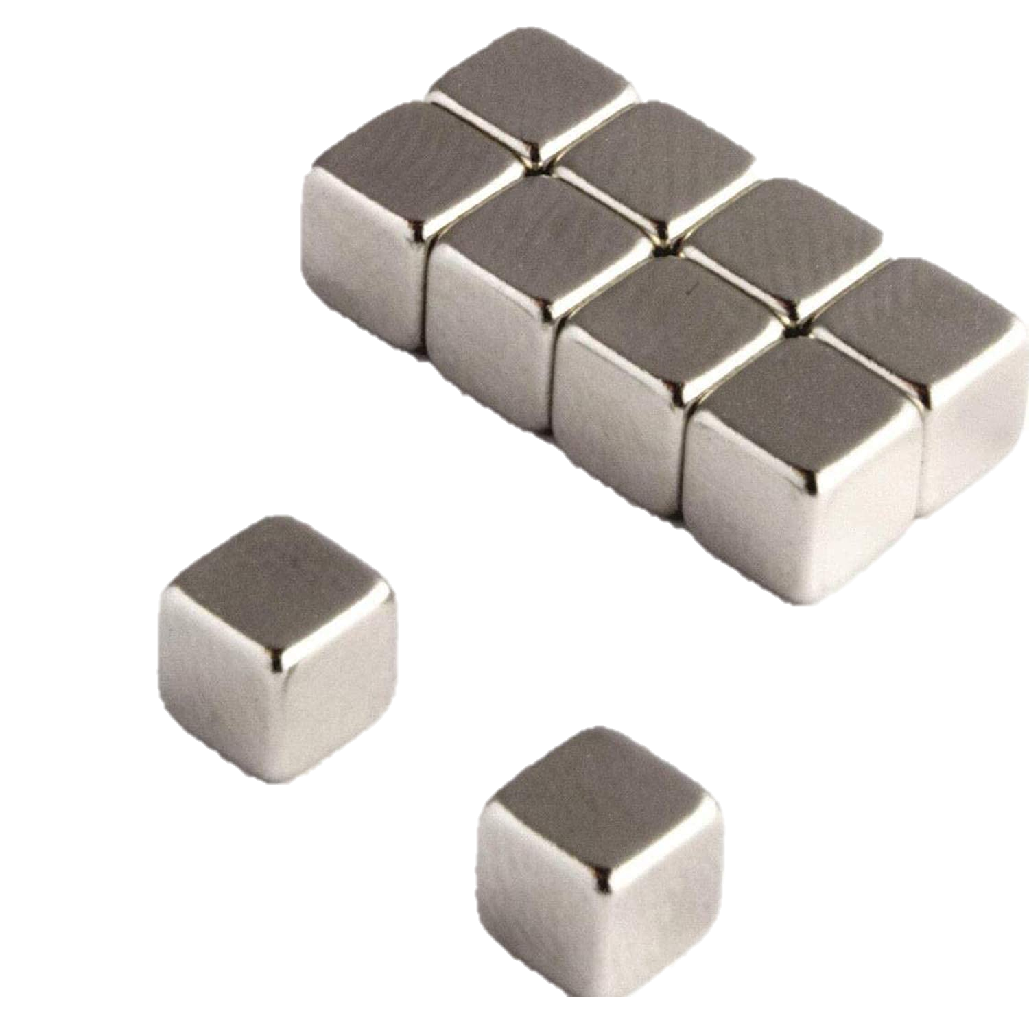
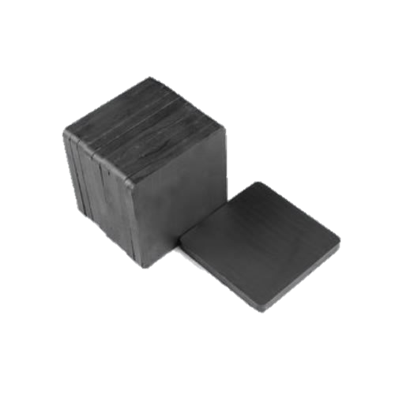
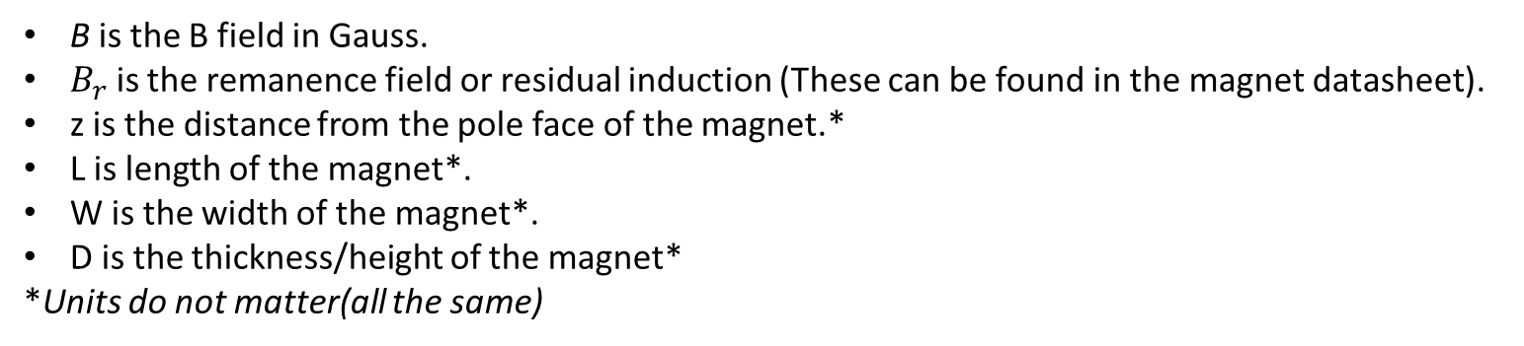
Formula for Square/Rectangle magnets
B is the B field in Gauss.
$B_{r}$ is the remanence field or residual induction (These can be found in the magnet datasheet).
z is the distance from the pole face of the magnet.*
L is length of the magnet*.
W is the width of the magnet*.
D is the thickness/height of the magnet*
*Units do not matter(all the same)

Slide 13
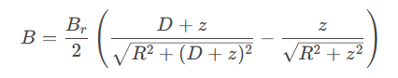
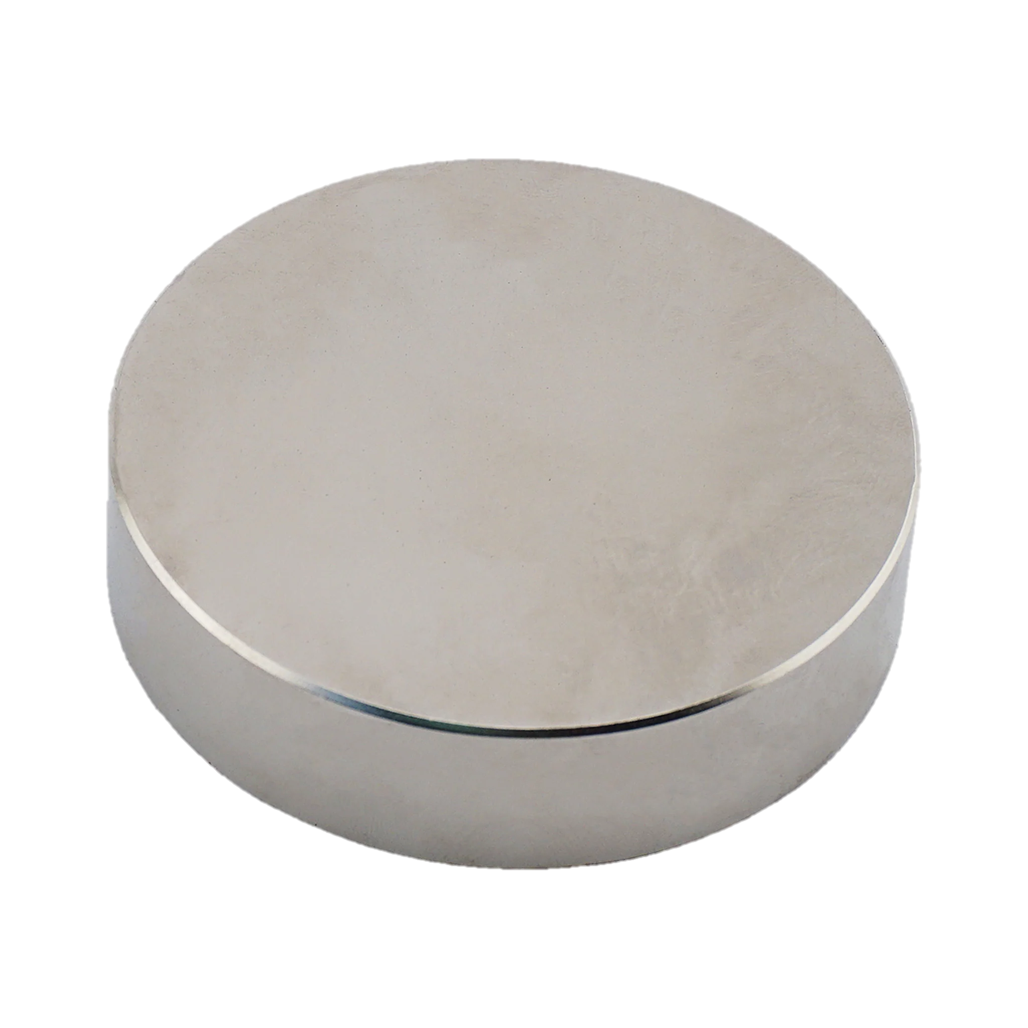
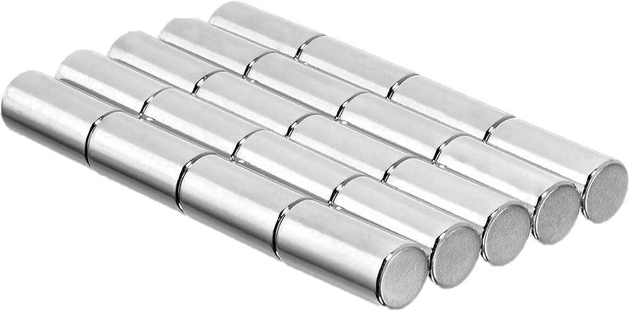
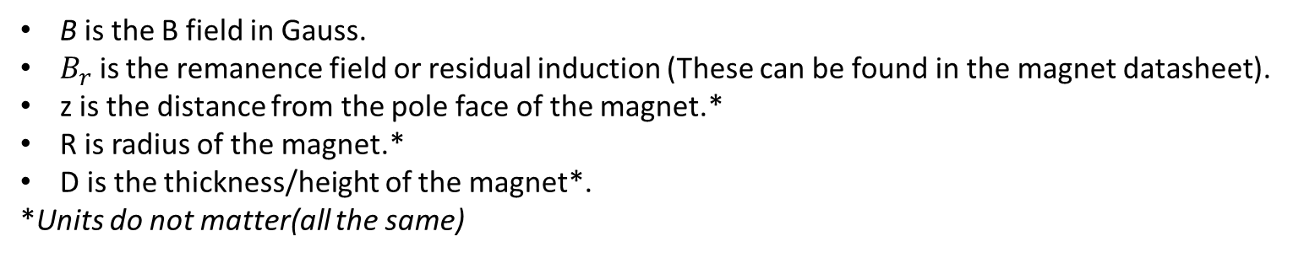
Formula for Disc/Rod magnets
B is the B field in Gauss.
$B_{r}$ is the remanence field or residual induction (These can be found in the magnet datasheet).
z is the distance from the pole face of the magnet.*
R is radius of the magnet.*
D is the thickness/height of the magnet*.
*Units do not matter(all the same)

Slide 14
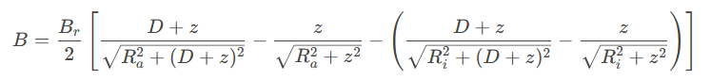
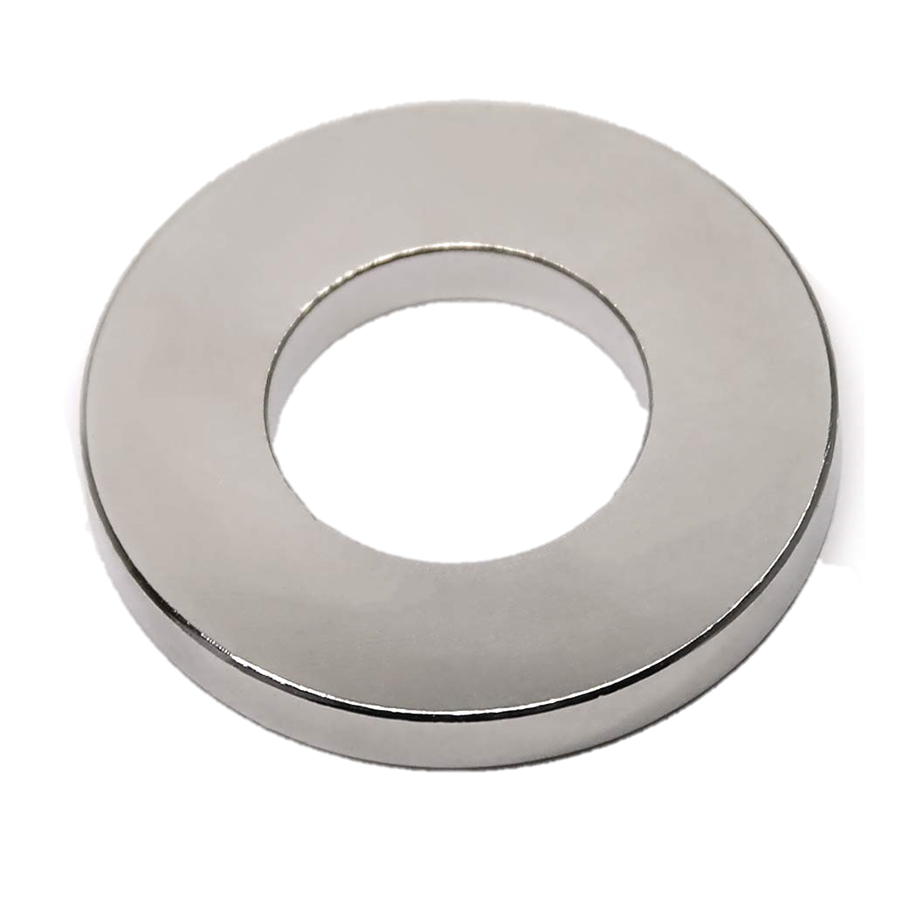
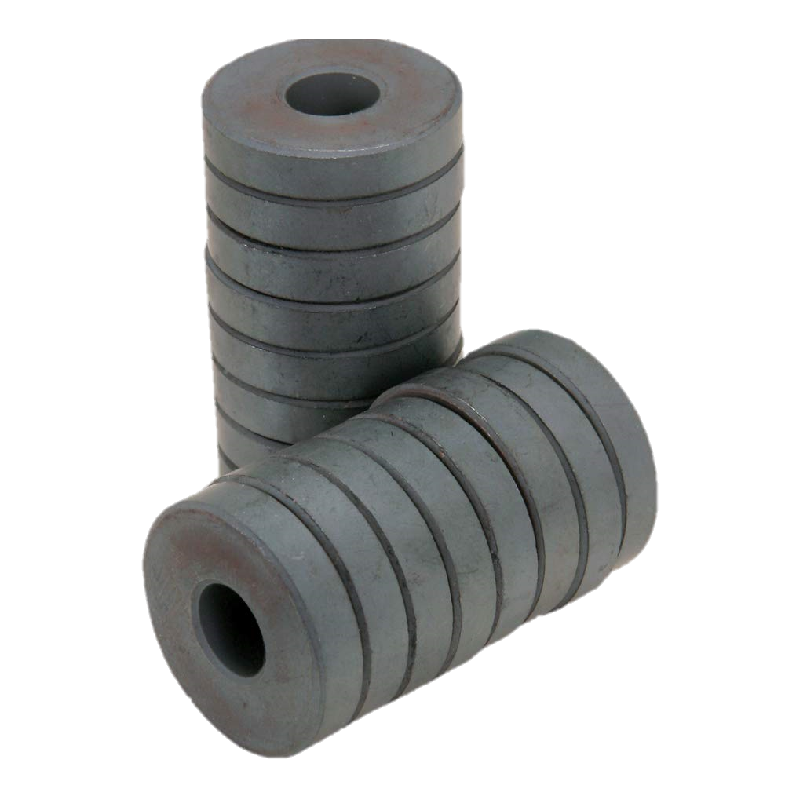
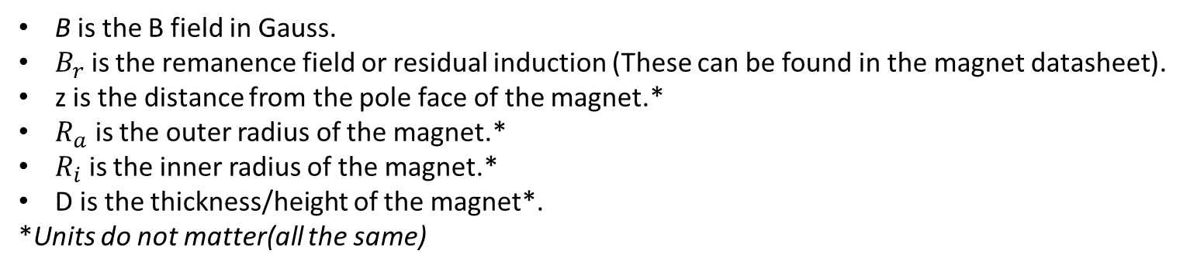
Formula for Ring Magnets
B is the B field in Gauss.
$B_{r}$ is the remanence field or residual induction (These can be found in the magnet datasheet).
z is the distance from the pole face of the magnet.*
$R_{a}$ is the outer radius of the magnet.*
$R_{i}$ is the inner radius of the magnet.*
D is the thickness/height of the magnet*.
*Units do not matter(all the same)

Slide 15
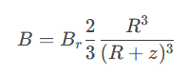
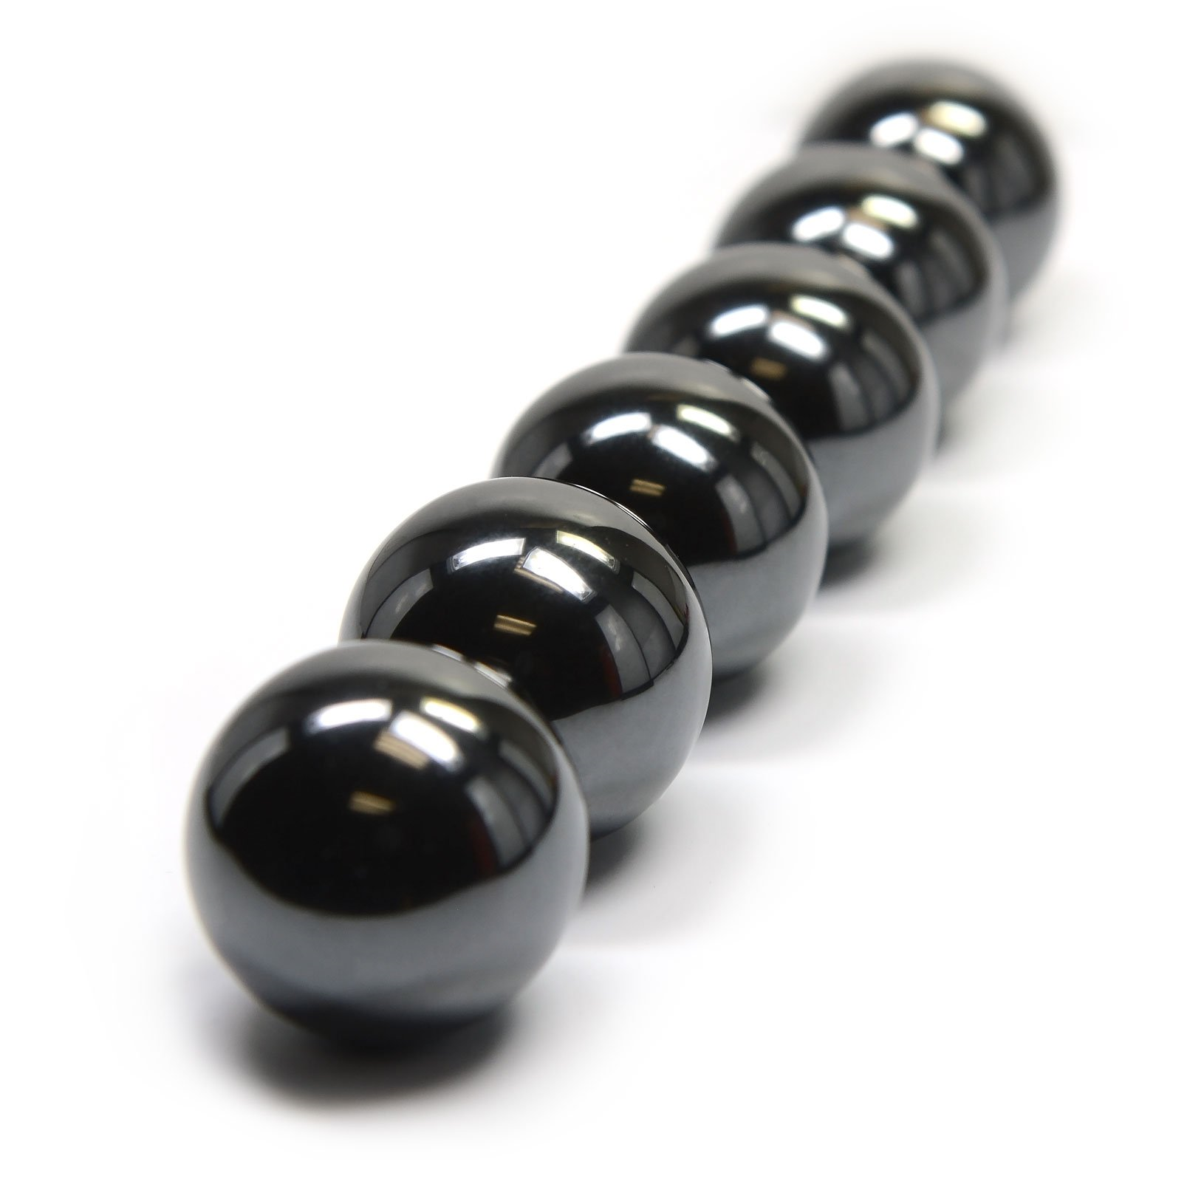
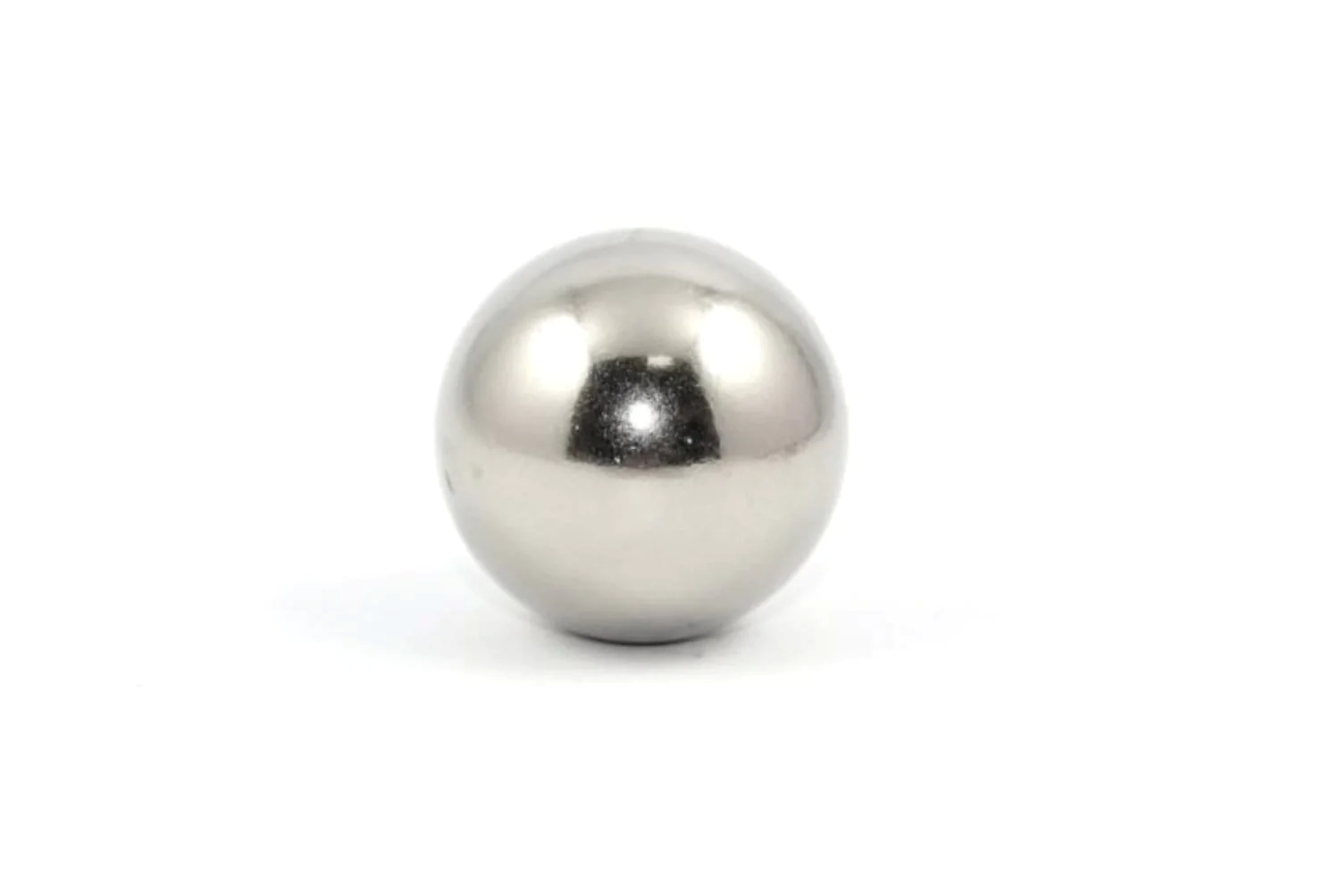
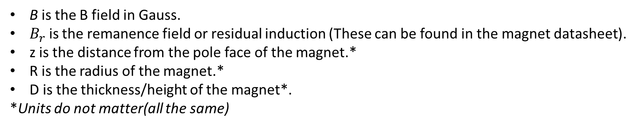
Formula for Sphere Magnets
B is the B field in Gauss.
$B_{r}$ is the remanence field or residual induction (These can be found in the magnet datasheet).
z is the distance from the pole face of the magnet.*
R is the radius of the magnet.*
D is the thickness/height of the magnet*.
*Units do not matter(all the same)

Slide 16
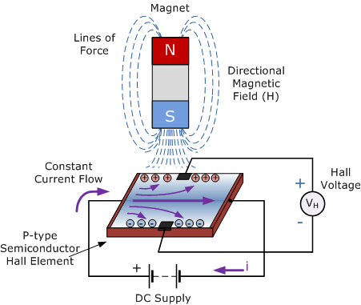
Conclusion

Slide 17
References
http://hyperphysics.phy-astr.gsu.edu/hbase/magnetic/Hall.html
The discovery of the Hall effect, G S LEADSTONE, Physics Department, Atlantic College, South Wales
https://www.electronics-tutorials.ws/electromagnetism/hall-effect.html
https://www.supermagnete.de/eng/faq/How-do-you-calculate-the-magnetic-flux-density

